Slide 1

S611AIPROJ
PROFESSIONAL TRAINING - II
AI POWERED RESUME ANALYZER
1. G Siri Jyothi (Reg no:42611138)
Internal Guide
Ms. R. YUGHA, M.E., Ph.D.,

Slide 2
PRESENTATION OUTLINE
COURSE CERTIFICATE
ABSTRACT
OBJECTIVES
SYSTEM ARCHITECTURE
PROJECT IMPLEMENTATION
RESULTS AND DISCUSSIONS
RESULT SNAPSHOTS
CONCLUSION & FUTURE WORK
REFERENCES

Slide 3
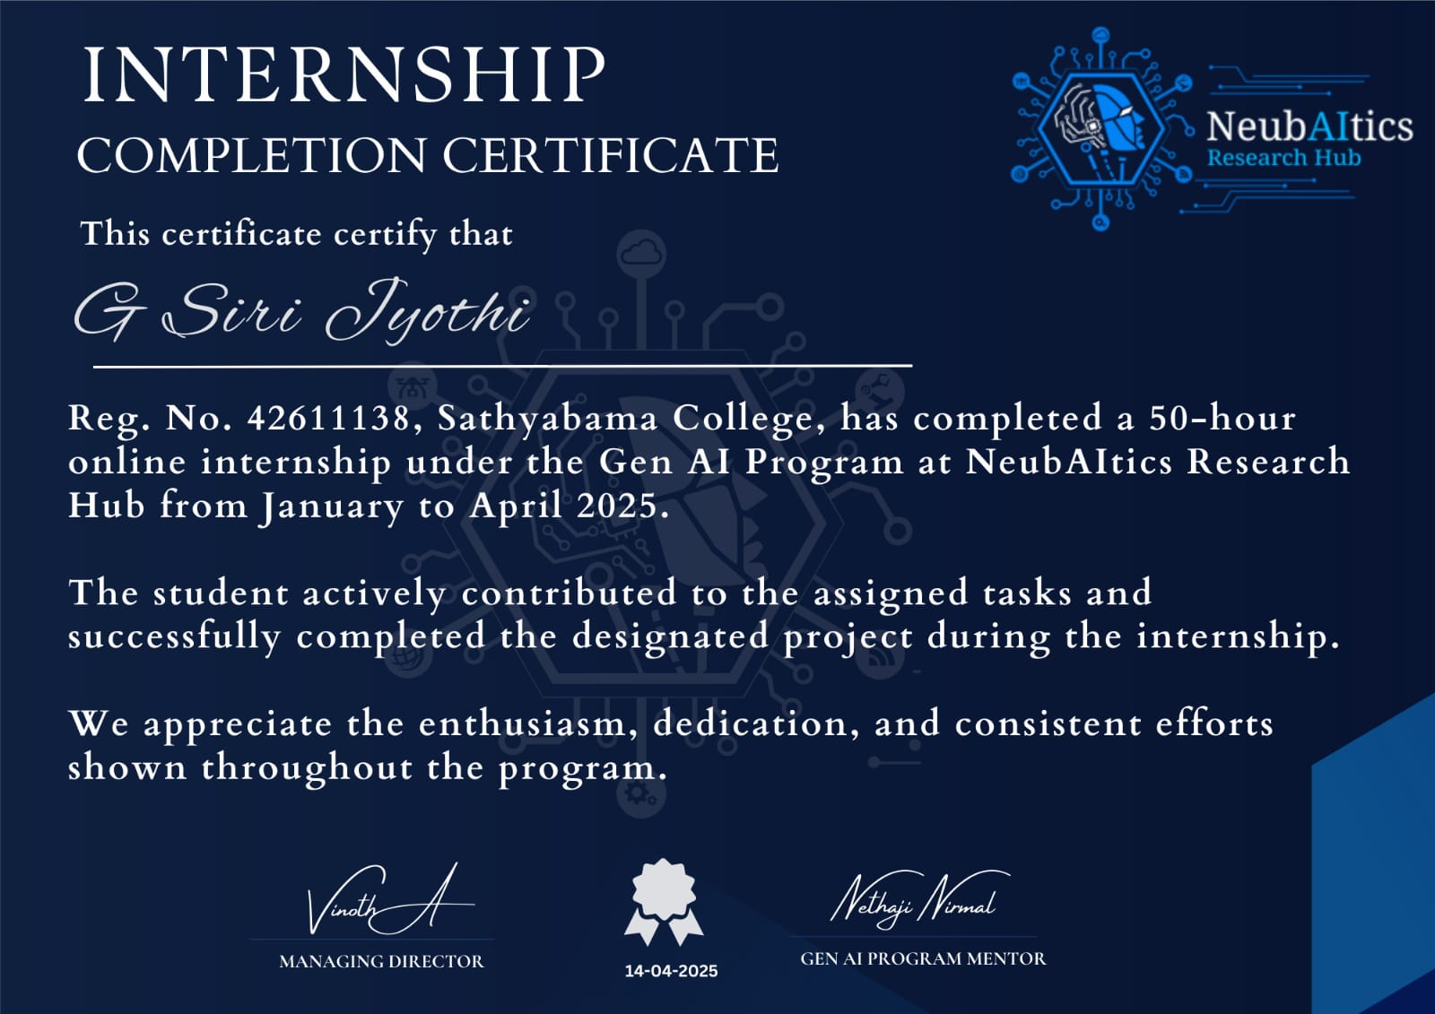
COURSE CERTIFICATE

Slide 4
ABSTRACT
Automates resume screening using NLP and machine learning to extract key candidate details from various formats (PDF, DOCX, etc.)
Compares resumes with job descriptions through keyword matching, semantic analysis, and similarity scoring
Ranks candidates based on relevance and job fit to streamline shortlisting
Offers skill gap analysis, customizable filters, and visual dashboards for better decision making
Reduces manual effort, minimizes bias, and improves evaluation accuracy
Scalable solution compatible with existing ATS, adaptable across industries for smarter, data-driven hiring decisions

Slide 5
OBJECTIVES
Emphasizes the importance of clear requirement analysis for guiding software design, implementation, testing, and deployment
Focuses on building a robust, user-friendly, and scalable Research Paper AI-powered resume analyzer adaptable to academic contexts
Defines both functional and non-functional requirements to ensure system effectiveness and usability
Processes uploaded PDFs to extract structured content for detailed analysis using advanced language models
Provides section summaries, identifies research gaps, and offers constructive suggestions beyond simple text summarization
Combines document parsing, NLP, large language models, and user-focused interface design to simulate human-like review feedback

Slide 6
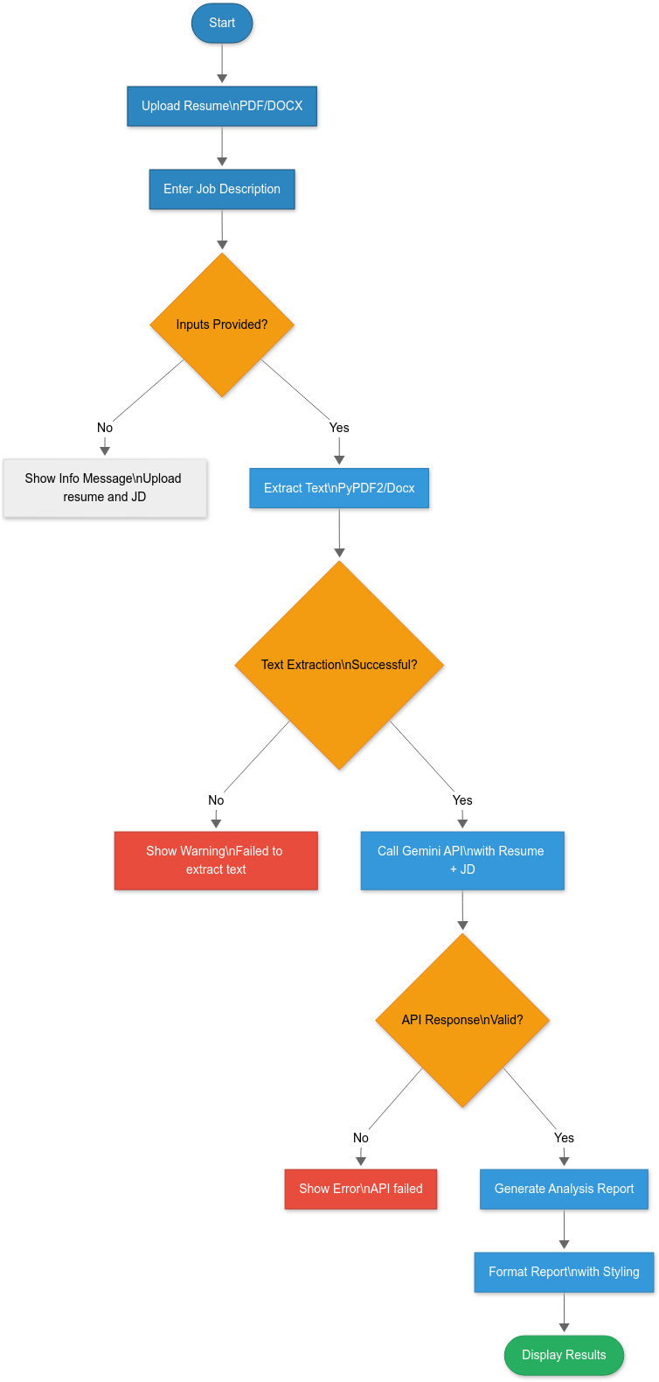
SYSTEM ARCHITECTURE

Slide 7
HARDWARE AND SOFTWARE REQUIREMENTS
Software Requirements
Jupyter Notebook - Project environment
Pandas – Convert dataset into data-frame
Matplot , Seaborn – Used to visualize the dataset
SkLearn module – To import all types ML algorithms
Hardware Requirements
GPU
Any Operating System

Slide 8
DATASET DESCRIPTION
0perates as a zero-shot and few-shot inference system, eliminating the need for precompiled or annotated datasets
Utilizes large pre-trained language models (LLMs) like GPT-3.5 or GPT-4 through API integration
Leverages knowledge from extensive corpora, including scientific journals, academic sites, books, and public domain content
LLMs serve as implicit datasets, having internalized patterns and norms of academic writing
Enables real-time interpretation and critique of documents without manual labeling or training data
Employs advanced prompt engineering to simulate expert-level analysis and feedback

Slide 9
RESULTS AND DISCUSSION
Confusion matrix and it’s related metrics given a good score, by this we can conclude that our model performed well.
This model is pretty good because by implementing all the steps above mentioned we got an accuracy equal to 99%.Therefore,it is a good model and our predictions will be effective .

Slide 10
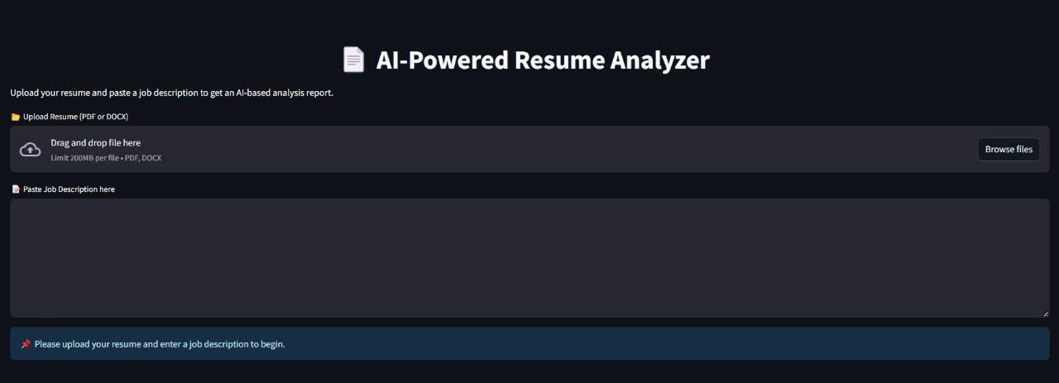
RESULTS AND DISCUSSION

Slide 11
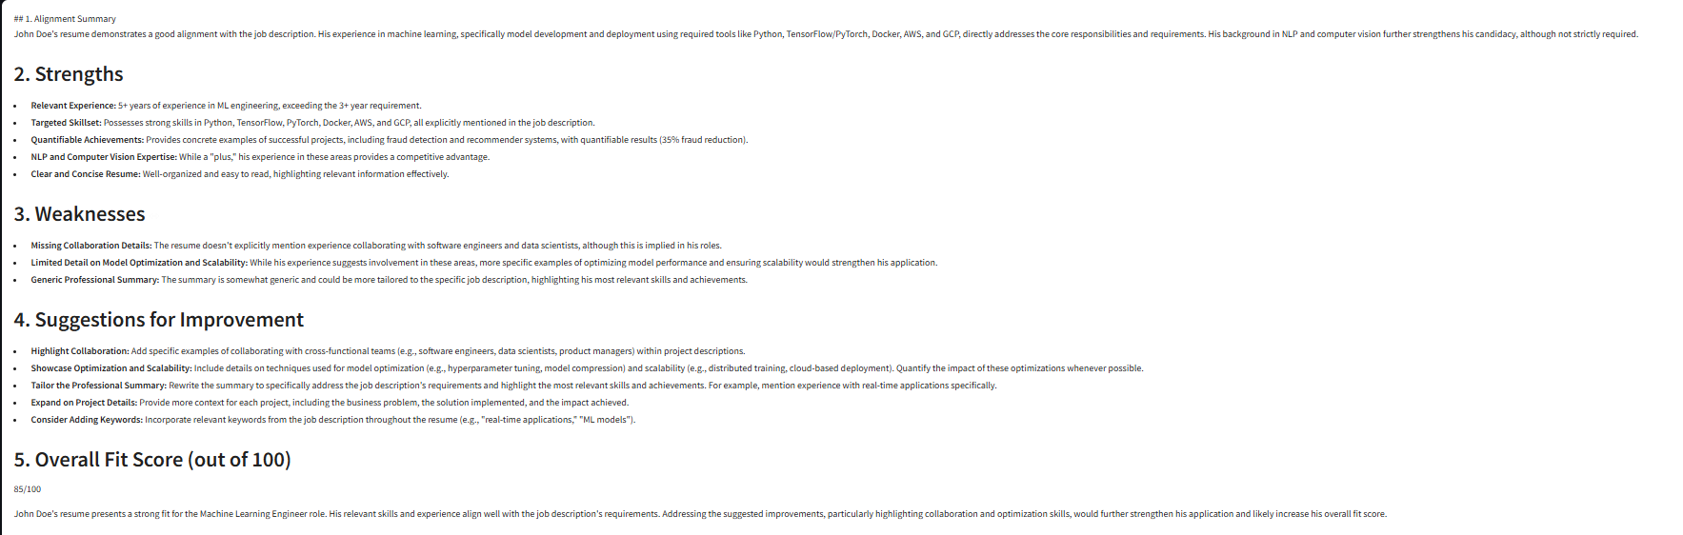
RESULTS AND DISCUSSION

Slide 12
CONCLUSION & FUTURE WORK
The Research Paper AI powered resume analyzer project set out with a focused and innovative objective: to develop an AI-powered tool that could analyze academic research papers and deliver comprehensive critiques, including section-wise summaries, identification of research gaps, and constructive suggestions for improvement. Leveraging the capabilities of Large Language Models (LLMs) and natural language processing (NLP), the system was designed, implemented, and successfully deployed as a web-based application on the Hugging Face Spaces platform. Through this project, the integration of intelligent automation with academic analysis was explored and proven to be both technically feasible and practically impactful.

Slide 13
REFERENCES
1]. Vaswani, A., Shazeer, N., Parmar, N., Uszkoreit, J., Jones, L., Gomez, A. N., ... & Polosukhin, I. (2017)
[2]. Nenkova, A., & McKeown, K. (2012). A survey of text summarization techniques. In
Mining Text Data (pp. 43–76). Springer.
[3]. Nenkova, A., & McKeown, K. (2012). A survey of text summarization techniques. In
Mining Text Data (pp. 43–76). Springer.
[4]. Jurafsky, D., & Martin, J. H. (2021). Speech and Language Processing (3rd ed. draft). Stanford University.
[5]. Radford, A., Narasimhan, K., Salimans, T., & Sutskever, I. (2018). Improving Language Understanding by Generative Pre-training.

Slide 14

AI POWERED RESUME ANALYZER

Slide 15

AI POWERED RESUME ANALYZER

